Slide 1
Personal Protective Equipment (PPE) for Workers in Construction Industry Who Enter Confined Spaces

Slide 2
Harwood Grant Disclaimer
This material was produced under grant number SH-39169-SH2 from the Occupational Safety and Health Administration, U.S. Department of Labor. It does not necessarily reflect the views or policies of the U.S. Department of Labor, nor does mention of trade names, commercial products, or organizations imply endorsement by the U.S. Government.

Slide 3
Introduction
Accidents occur during confined space operations because employers fail to recognize hazards and establish control measures.
It is critical that employers recognize and control hazards at the workplace.
Although PPE is considered the least effective method, it is important to select the appropriate PPE for the specific hazard that workers encounter during their task.

Slide 4
Objectives
Identify the requirements of a PPE standard in construction
2
Recognize common hazards that workers encounter during confined space operations that may require use of PPE
3
Describe limitations, proper care and how to inspect PPE
4
Understand worker rights and employer responsibilities
1
Describe a behavior-based safety program and how to promote a safety culture
5

Slide 5
OSHA
OSHA’s Mission
With the Occupational Safety and Health Act of 1970, Congress created the Occupational Safety and Health Administration (OSHA) to ensure safe and healthful working conditions for workers by setting and enforcing standards and by providing training, outreach, education and assistance.

Slide 6
Worker Rights & Employer Responsibilities

Slide 7
OSHA’s Whistleblower Protection Program
An employer cannot retaliate against you for exercising your rights under the Department of Labor’s whistleblower protection laws.
https://www.osha.gov/sites/default/files/publications/OSHA3638.pdf

Slide 8
What is Retaliation?
Retaliation occurs when an employer (through a manager, supervisor, or administrator) fires an employee or takes any other type of adverse action against an employee for engaging in protected activity.
Retaliation includes such actions as:
Firing
Laying off
Demoting
Denying overtime or promotion
Reducing pay or hours
An adverse action is an action which would dissuade a reasonable employee from raising a concern about a possible violation or engaging in other related protected activity.
https://www.osha.gov/sites/default/files/publications/OSHA3638.pdf

Slide 9
Applicable Regulations
1926 Subpart C - General Safety and Health Provisions
https://www.osha.gov/laws-regs/regulations/standardnumber/1926/1926SubpartC
1926.28 - Personal Protective Equipment
https://www.osha.gov/laws-regs/regulations/standardnumber/1926/1926.28
The employer is responsible for requiring the wearing of appropriate personal protective equipment in all operations where there is an exposure to hazardous conditions or where the need for using such equipment to reduce the hazards to the employees.
1926 Subpart E - Personal Protective and Life Saving Equipment
https://www.osha.gov/laws-regs/regulations/standardnumber/1926/1926SubpartE
1926 Subpart AA - Confined Spaces in Construction
https://www.osha.gov/laws-regs/regulations/standardnumber/1926/1926SubpartAA

Slide 10
Definitions
Protective Equipment- includes personal protective equipment (PPE) for eyes, face, head, and extremities, protective clothing, respiratory devices, and protective shields and barriers
Example: glasses, face shield, hard hats, N95, earplugs
Confined space- a space that:
Is large enough and so configured that an employee can bodily enter it;
Has limited or restricted means for entry and exit; and
Is not designed for continuous employee occupancy

Slide 11
Criteria for Personal Protective Equipment (PPE)
Personal Protective equipment (PPE) shall be provided, used, and maintained in a sanitary and reliable condition wherever it is necessary by:
hazards of processes or environment
chemical hazards
radiological hazards
mechanical irritants
Encountered in a manner capable of causing injury or impairment in the function of any part of the body through absorption, inhalation or physical contact.

Slide 12
Employee - Owned Equipment
Where employees provide their own protective equipment, the employer shall be responsible to assure its adequacy, including proper maintenance, and sanitation of such equipment.
Notes:
1926.95(b) “Employee-owned equipment.“
Where employees provide their own protective equipment, the employer shall be responsible to assure its adequacy, including proper maintenance, and sanitation of such equipment.

Slide 13
Design of the Equipment
All personal protective equipment shall be of safe design and construction for the work to be performed.
Notes:
1926.95(c) All personal protective equipment shall be of safe design and construction for the work to be performed.

Slide 14
Payment for Protective Equipment - Requirements
The protective equipment, including personal protective equipment (PPE), used, shall be provided by the employer at no cost to employees
The employer is not required to pay for non-specialty safety-toe protective footwear (including steel-toe shoes or steel-toe boots) and non-specialty prescription safety eyewear, provided that the employer permits such items to be worn off the job-site
When the employer provides metatarsal guards and allows the employee, at his or her request, to use shoes or boots with built-in metatarsal protection, the employer is not required to reimburse the employee for the shoes or boots
Review Handout: https://www.osha.gov/sites/default/files/Handout_2_Employers_Must_Provide_and_Pay_for_PPE.pdf
Notes:
1926.95(d)

Slide 15
Payment for Protective Equipment
The employer is not required to pay for:
Everyday clothing, such as long-sleeve shirts, long pants, street shoes, and normal work boots; or
Ordinary clothing, skin creams, or other items, used solely for protection from weather, such as winter coats, jackets, gloves, parkas, rubber boots, hats, raincoats, ordinary sunglasses, and sunscreen
Notes:
1926.95(d)

Slide 16
Payment for Protective Equipment (continued)
The employer must pay for replacement PPE, except when the employee has lost or intentionally damaged the PPE
Where an employee provides adequate protective equipment, the employer may allow the employee to use it and is not required to reimburse the employee for that equipment
The employer shall not require an employee to provide or pay for his or her own PPE, unless the PPE is excepted by the regulation
Notes:
1926.95(d)
https://www.osha.gov/laws-regs/regulations/standardnumber/1926/1926.95

Slide 17
Training
Employer shall instruct each employee in the recognition and avoidance of unsafe conditions and the regulations applicable to the work environment to eliminate or control any hazards or other exposure to illness or injury

Slide 18
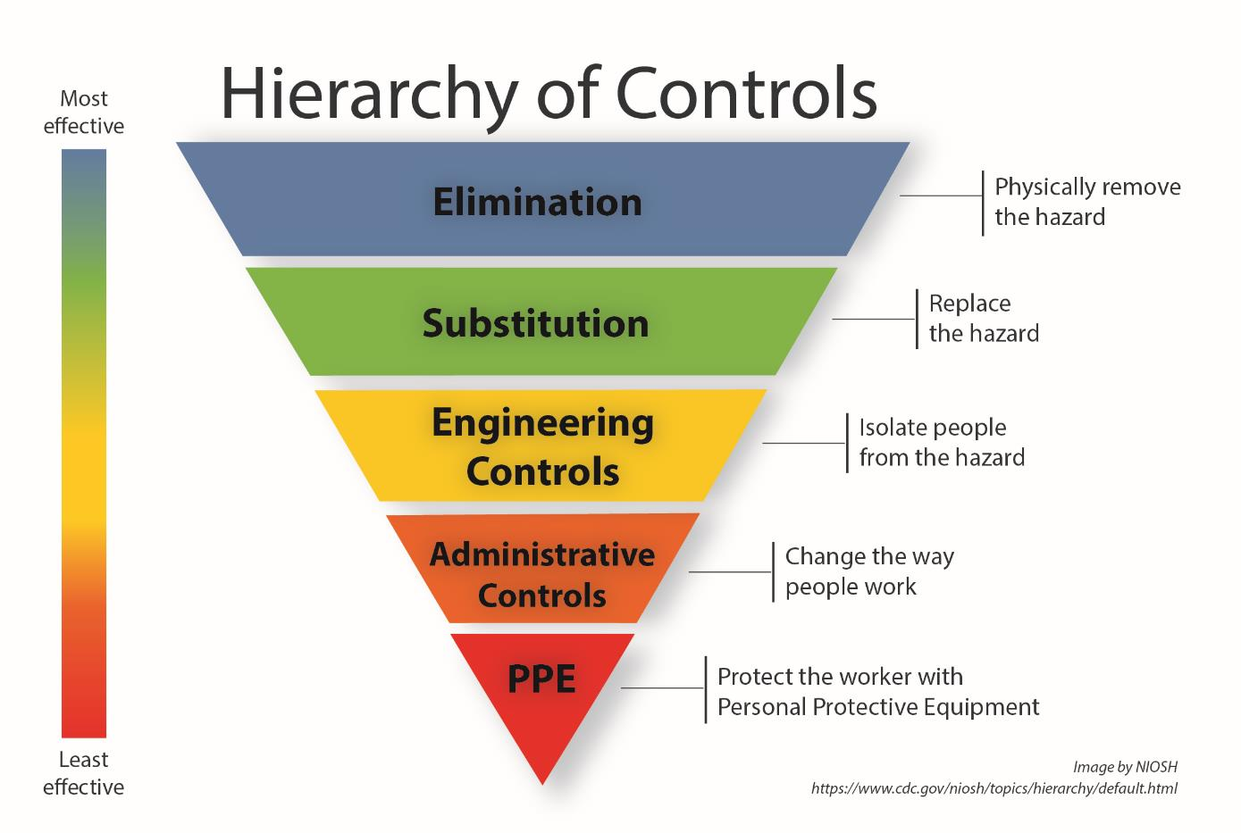
Recognizing Hazards and Protecting Employees
Employers must institute all feasible engineering and work practice controls to eliminate and reduce hazards before using PPE to protect against hazards.

Slide 19
Hazards
Common hazards that workers encounter in confined spaces:
Chemical
Heat
Impact
Compression
Penetration
Dust
Falls

Slide 20
1926 Subpart E
1926 Subpart E
Personal Protective and Life Saving Equipment
Notes:
1926 Subpart E - Personal Protective and Life Saving Equipment
https://www.osha.gov/laws-regs/regulations/standardnumber/1926/1926SubpartE

Slide 21
1926 Subpart E - Personal Protective and Life Saving Equipment
1926.96 - Occupational foot protection
1926.100 - Head protection
1926.101 - Hearing protection
1926.102 - Eye and face protection
1926.103 - Respiratory protection
1926.104 - Safety belts, lifelines, and lanyards
1926.105 - Safety nets
https://www.osha.gov/laws-regs/regulations/standardnumber/1926/1926SubpartE
Notes:
1926 Subpart E - Personal Protecti
https://www.osha.gov/laws-regs/regulations/standardnumber/1926/1926SubpartEve and Life Saving Equipment

Slide 22
1926.96 Foot Protection
Standard Requirements: Safety-toe footwear for employees shall meet the requirements and specifications in American National Standard for Men's Safety-Toe Footwear, Z41.1-1967.

Slide 23
Foot Protection - Hazards
Common hazards in a confined space:
Molten metal or welding sparks
Impact and compression (heavy objects or tools that may roll, fall onto, or strike)
Electrical hazards (exposed electrical wiring or components)
Chemical hazards (corrosive chemicals)
Wet or slippery surfaces

Slide 24
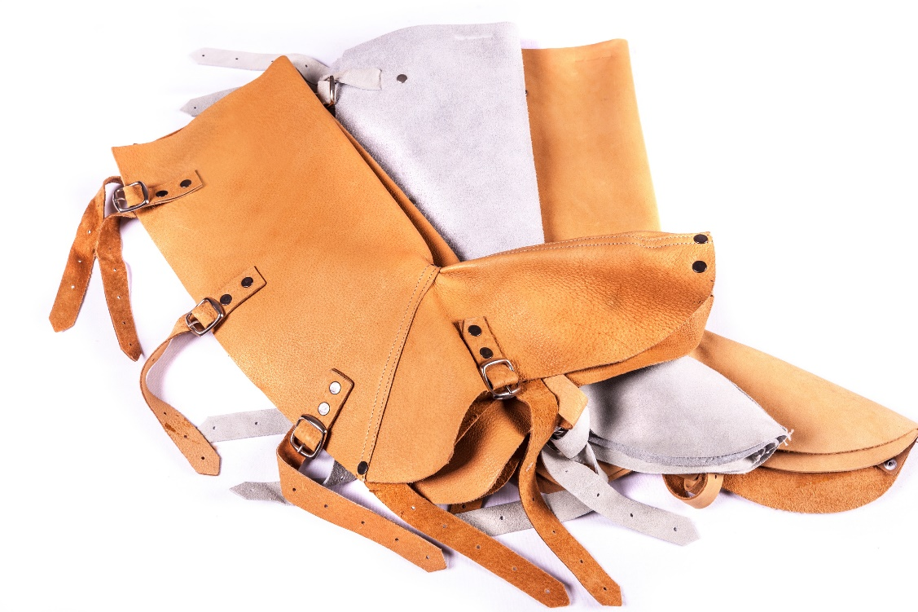
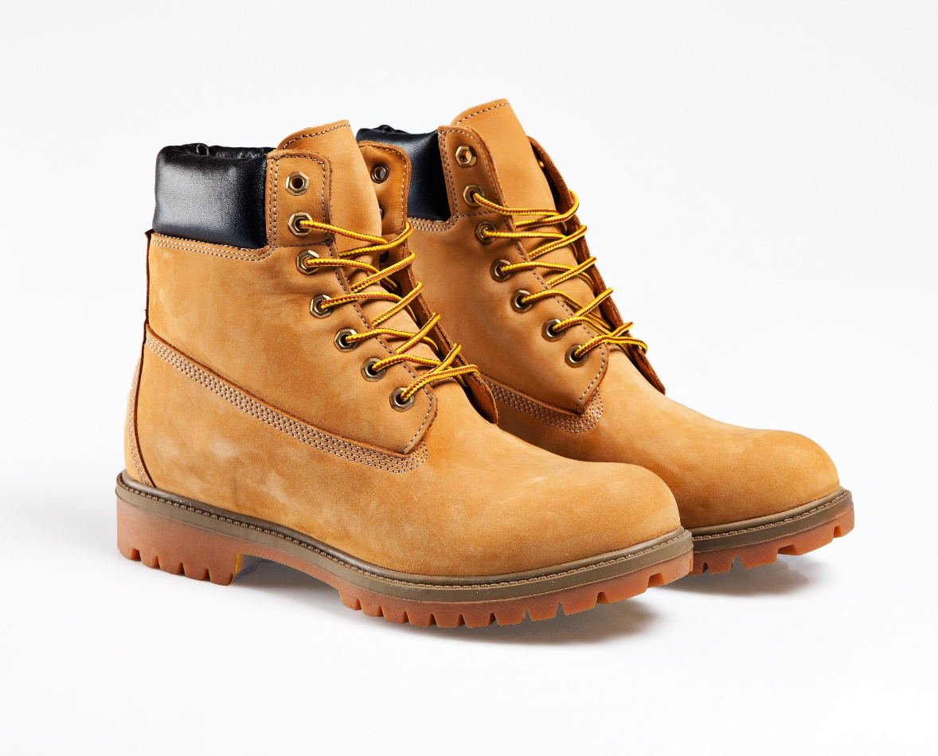
Foot Protection - Examples
Examples of PPE:
Leggings
Metatarsal guards
Toe guards
Safety shoes (boots)
Rubber boots

Slide 25
Foot Protection Use and Care
How to properly put on the PPE.
How to adjust straps, laces, and other parts.
Training: Use and care
Limitations of foot or leg protection: Poorly fitting safety shoes can result in bunions, corns, calluses, and other foot problems
Inspection:
Scuffed, cracked, or lacerated uppers
Signs of separation between soles and uppers
Holes or cracks in soles or heels
Metal embedded in heels or soles or electrical hazard, safety-toe shoes
Care: How to clean and maintain leg and foot protection?
Notes:
Don’t purchase safety shoes that need to be broken in.
The toe box needs to be deep enough so you can move all your toes inside without feeling pressure.

Slide 26
Let’s Review : Foot Protection
Why is foot protection necessary?
Give examples of foot protection.
What are some common confined space hazards that threaten feet or legs?
How will foot protection protect you from the hazards in a confined space?

Slide 27
1926.100 - Head Protection
Standard Requirements:
Employees working in areas where there is a possible danger of head injury from impact, or from falling or flying objects, or from electrical shock and burns, shall be protected by protective helmets.
Criteria for head protection
The employer must provide each employee with head protection that meets the specifications contained on the consensus standards
The employer must ensure that the head protection provided for each employee exposed to high-voltage electric shock and burns also meets the specifications
Notes:
1926.100(a)Employees working in areas where there is a possible danger of head injury from impact, or from falling or flying objects, or from electrical shock and burns, shall be protected by protective helmets.
1926.100(b)Criteria for head protection.
1926.100(b)(1)The employer must provide each employee with head protection that meets the specifications contained in any of the following consensus standards:
1926.100(b)(1)(i)American National Standards Institute (ANSI) Z89.1-2009, "American National Standard for Industrial Head Protection," incorporated by reference in §1926.6;
1926.100(b)(1)(ii)American National Standards Institute (ANSI) Z89.1-2003, "American National Standard for Industrial Head Protection," incorporated by reference in §1926.6; or
1926.100(b)(1)(iii)American National Standards Institute (ANSI) Z89.1-1997, "American National Standard for Personnel Protection-Protective Headwear for Industrial Workers-Requirements," incorporated by reference in §1926.6.
1926.100(b)(2)The employer must ensure that the head protection provided for each employee exposed to high-voltage electric shock and burns also meets the specifications contained in Section 9.7 ("Electrical Insulation") of any of the consensus standards identified in paragraph (b)(1) of this section.
https://www.osha.gov/laws-regs/regulations/standardnumber/1926/1926.100

Slide 28
Head Protection – Common Hazards
Common hazards in a confined space:
Objects or tools may fall from above and strike the head
Low hanging objects or protruding objects (ex: exposed beams or pipes)
Working with or near exposed electrical wiring or components

Slide 29
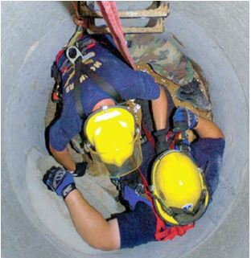
Head Protection - Examples
Example of PPE:
Hard hats
Characteristics:
Resist penetration by objects
Absorb shock
Water resistant

Slide 30
Head Protection (continued)
Workers should:
Read the instructions
Check the hard hat label for the appropriate class
Use and adjust hard hats properly
Replace the suspension and head band (if needed)
Not alter or modify hard hats

Slide 31
Head Protection - Classifications
Classification: Use of hard hat (electrical protection)
Class | Electrical Protection | Description
E - Electrical | Up to 20,000 volts | Protect against falling objects and high-voltage shock and burns
G - General | Up to 2,200 volts | Good impact protection but limited voltage protection
C - Conductive | Offers no electrical protection | Designed for comfort, offers limited protection
American National Standards Institute in ANSI Z89.1, which provides overall standards for certification of head protection. https://blog.ansi.org/2016/06/ansiisea-z891-industrial-head-protection/#gref

Slide 32
Head Protection – Classifications (continued)
Classification: Protection of the Hard Hat
Type | Protection
I | Protects the top of the head from impacts (ex: falling objects)
II | Protects the top and lateral sections of the head from impacts (ex: bumping into a stationary object)

Slide 33
Head Protection – Use and Care
Video:
How to wear the hard hat properly.
How to adjust straps and other parts.
Training: Use and care
Limitations of head protection: If objects are particularly heavy, or fall from a considerable height, your neck or spine could still be damaged
Inspection: How to identify signs of wear such as:
Cracked, torn, frayed, or otherwise deteriorated suspension systems;
Deformed, cracked, or perforated brims or shells; and
Flaking, chalking, or loss of surface gloss
Care: How to clean and disinfect hard hats?

Slide 34
Let’s Review : Head Protection
Why is head protection necessary?
Give examples of head protection
What are some common confined space hazards that threaten your head?
How will head protection protect you from hazards in a confined space?

Slide 35
1916.101-Hearing Protection
Standard Requirements:
Wherever it is not feasible to reduce the noise levels or duration of exposures to those specified in Table D-2, Permissible Noise Exposures, in 1926.52, ear protective devices shall be provided and used
Ear protective devices inserted in the ear shall be fitted or determined individually by competent persons
Plain cotton is not an acceptable protective device
Notes:
1926.101 - Hearing protection.
https://www.osha.gov/laws-regs/regulations/standardnumber/1926/1926.101

Slide 36
Table D-2 - Permissible Noise Exposures
Duration per day, hours | Sound level dBA slow response
8 | 90
6 | 92
4 | 95
3 | 97
2 | 100
1½ | 102
1 | 105
½ | 110
¼ or less | 115
In all cases where the sound levels exceed the values in table D-2, an effective hearing conservation program shall be administered.
Notes:
1926.52(d)(1) In all cases where the sound levels exceed the values shown herein, a continuing, effective hearing conservation program shall be administered.

Slide 37
Hearing Protection
Common hazards in a confined space:
Exposed to loud noise (machines, tools)
Note: Sounds generated by tools and heavy machinery can be magnified and reverberated within confined spaces.
Notes:
Sounds generated by tools and heavy machinery can be magnified and reverberated within confined spaces. Noise may impede verbal communication between workers.

Slide 38
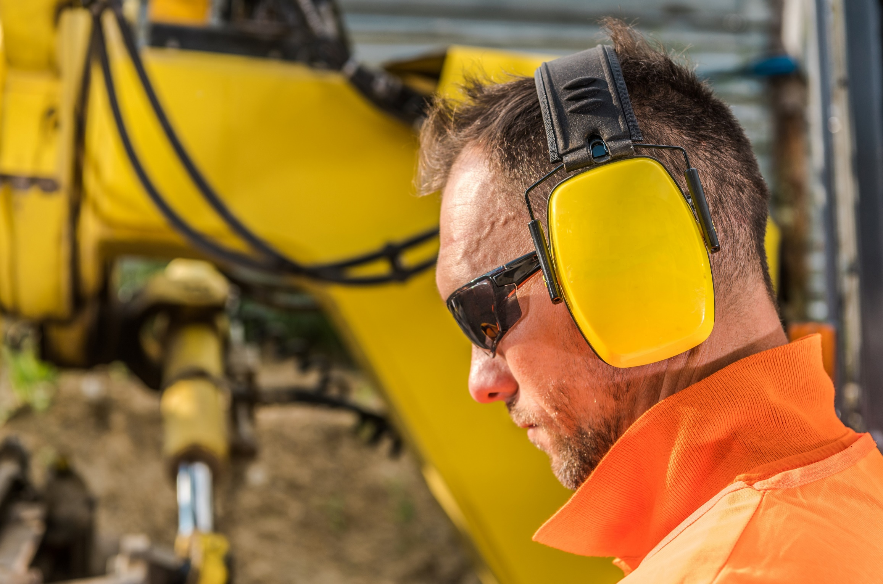
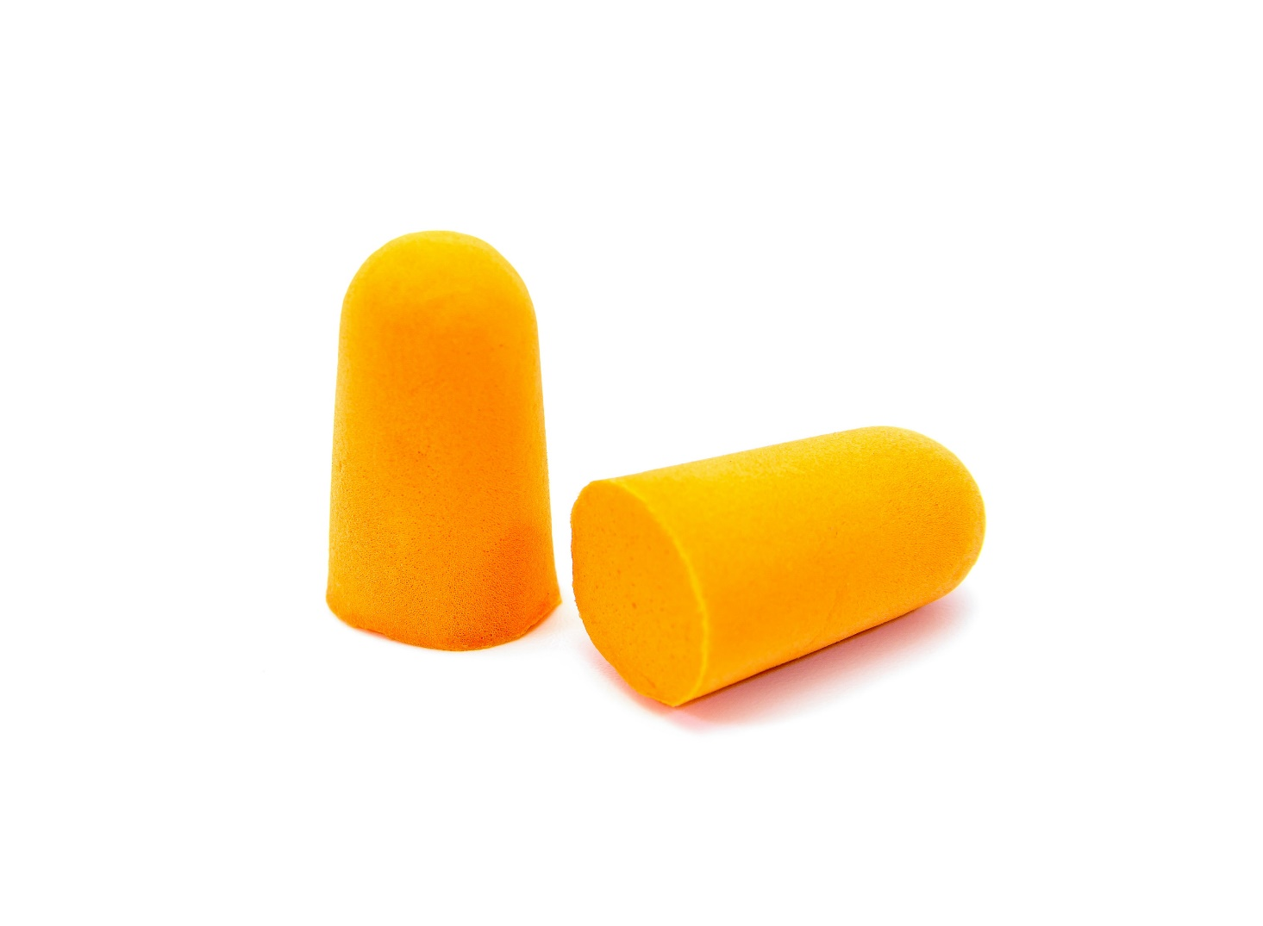
Hearing Protection - Examples
Examples of PPE:
Earplugs
Earmuffs
Notes:
Sounds generated by tools and heavy machinery can be magnified and reverberated within confined spaces. Noise may impede verbal communication between workers.

Slide 39
Hearing Protection – Use and Care
Video:
When hearing protectors must be inserted.
How to adjust hearing protection.
Training : Use and Care
Limitations of hearing protection:
Earplugs - more difficult to insert and remove and may irritate the ear canal
Earmuffs - more uncomfortable in hot, humid work and more inconvenient for use in confined work areas. May interfere with the wearing of safety or prescription glasses.
Inspection: How to identify signs of wear such as:
Broken or tear (plugs that are no longer pliable)
Check that head bands are not so stretched that they do not keep ear cushions snugly against the head
Care: How to clean and disinfect hearing protection?
Notes:
To clean.
Wash earmuffs with a mild liquid detergent in warm water, and then rinse in clear warm water. Ensure that the sound-attenuating material inside the ear cushions does not get wet.
Use a soft brush to remove skin oil and dirt that can harden ear cushions.
Squeeze excess moisture from the plugs or cushions and then place them on a clean surface to air dry. (Check the manufacturer's recommendations first to find out if the earplugs are washable.)

Slide 40
Let’s Review : Hearing Protection
Why is hearing protection necessary?
Give examples of hearing protection
What are some common confined space hazards that threaten hearing?
How will head protection protect you from the hazards in a confined space?

Slide 41
1926.102- Eye and Face Protection
Standard Requirements:
The employer shall ensure that each affected employee uses appropriate eye or face protection:
when exposed to eye or face hazards from flying particles, molten metal, liquid chemicals, acids or caustic liquids, chemical gases or vapors, or potentially injurious light radiation
that provides side protection when there is a hazard from flying objects
Notes:
1926.102 - Eye and face protection.
Detachable side protectors (e.g. clip-on or slide-on side shields) meeting the pertinent requirements of this section are acceptable.
https://www.osha.gov/laws-regs/regulations/standardnumber/1926/1926.102

Slide 42
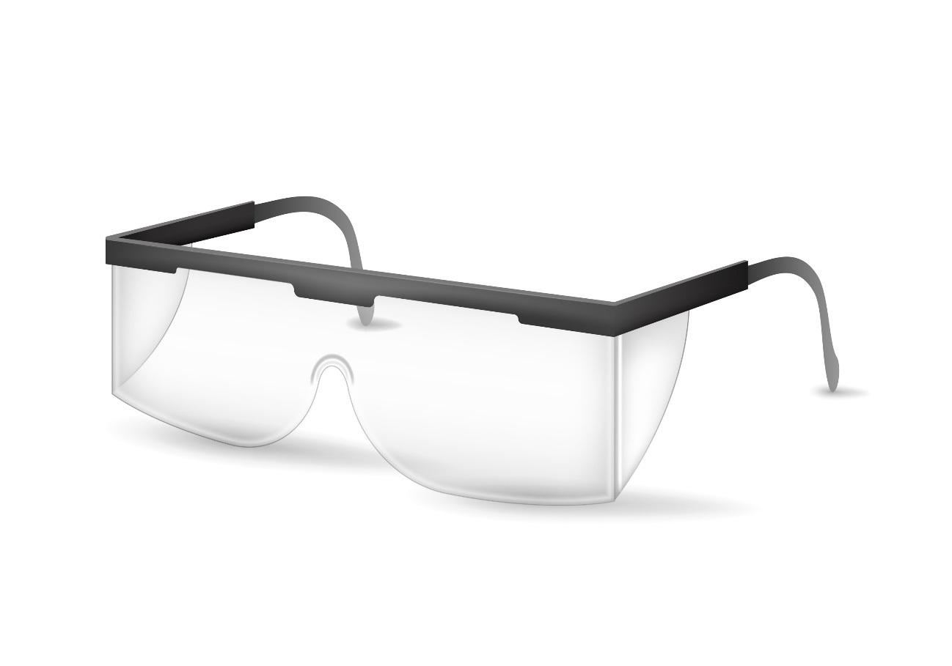
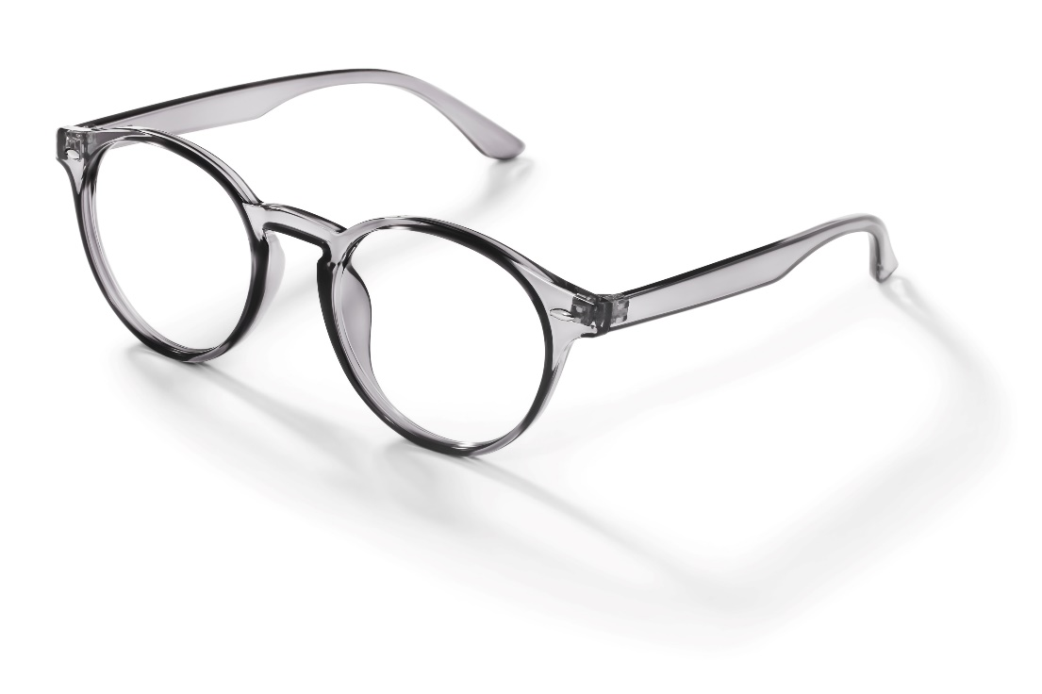
1926.102- Eye and Face Protection (continued)
Standard Requirements:
The employer shall ensure that each affected employee who wears prescription lenses while engaged in operations that involve eye hazards wears eye protection that incorporates the prescription in its design, or wears eye protection that can be worn over the prescription lenses without disturbing the proper position of the prescription lenses or the protective lenses
Notes:
1926.102 - Eye and face protection.
Detachable side protectors (e.g. clip-on or slide-on side shields) meeting the pertinent requirements of this section are acceptable.
https://www.osha.gov/laws-regs/regulations/standardnumber/1926/1926.102

Slide 43
Eye and Face Protection
Standard Requirements:
Eye and face PPE shall provide adequate protection against the hazards for which they are designed
Shall be:
Reasonably comfortable when worn under the designated conditions
Fit snugly and shall not unduly interfere with the movements of the wearer
Durable
Capable of being disinfected and be easily cleanable

Slide 44
Eye and Face Protection - Criteria
Criteria for protective eye and face protection:
Protective eye and face protection devices must comply with any of the following consensus standards:
ANSI/ISEA Z87.1-2010
ANSI Z87.1-2003, or
ANSI Z87.1-1989
Notes:
1926.102(b)Criteria for protective eye and face protection.
1926.102(b)(1)Protective eye and face protection devices must comply with any of the following consensus standards:
1926.102(b)(1)(i)ANSI/ISEA Z87.1-2010, Occupational and Educational Personal Eye and Face Protection Devices, incorporated by reference in § 1926.6;
1926.102(b)(1)(ii)ANSI Z87.1-2003, Occupational and Educational Personal Eye and Face Protection Devices, incorporated by reference in § 1926.6; or
1926.102(b)(1)(iii)ANSI Z87.1-1989 (R-1998), Practice for Occupational and Educational Eye and Face Protection, incorporated by reference in § 1926.6;
1926.102(b)(2)Protective eye and face protection devices that the employer demonstrates are at least as effective as protective eye and face protection devices that are constructed in accordance with one of the above consensus standards will be deemed to be in compliance with the requirements of this section.
https://www.osha.gov/laws-regs/interlinking/standards/1926.102(b)

Slide 45
Eye and Face Protection – Radiant Energy
Welding operation | Shade number
Shielded metal-arc welding 1/16-, 3/32-, 1/8-, 5/32-inch diameter electrodes | 10
Gas-shielded arc welding (nonferrous) 1/16-, 3/32-, 1/8-, 5/32-inch diameter electrodes | 11
Gas-shielded arc welding (ferrous) 1/16-, 3/32-, 1/8-, 5/32-inch diameter electrodes | 12
Shielded metal-arc welding 3/16-, 7/32-, 1/4-inch diameter electrodes | 12
5/16-, 3/8-inch diameter electrodes | 14
Atomic hydrogen welding | 10-14
Carbon-arc welding | 14
Soldering | 2
Torch brazing | 3 or 4
Light cutting, up to 1 inch | 3 or 4
Medium cutting, 1 inch to 6 inches | 4 or 5
Heavy cutting, over 6 inches | 5 or 6
Gas welding (light), up to 1/8-inch | 4 or 5
Gas welding (medium), 1/8-inch to 1/2-inch | 5 or 6
Gas welding (heavy), over 1/2-inch | 6 or 8
Protection against radiant energy
Selection of shade numbers for welding filter
Table E-1 shall be used as a guide for the selection of the proper shade numbers of filter lenses or plates used in welding. Shades more dense than those listed may be used to suit the individual’s needs.
Table E-1-Filter Lens Shade Numbers for Protection Against Radiant Energy

Slide 46
Eye and Face Protection – Laser Protection
Laser Protection
Employees exposed to laser beams shall be furnished suitable laser safety goggles which will protect for the specific wavelength of the laser and be of optical density (O.D.) adequate for the energy involved
Table E-2 lists the maximum power or energy density for which adequate protection is afforded by glasses of optical densities from 5 through 8. Output levels falling between lines in this table shall require the higher optical density.
All protective goggles shall bear a label identifying the following data:
The laser wavelengths for which use is intended
The optical density of those wavelengths
The visible light transmission

Slide 47
Eye and Face Protection – Laser Protection (continued)
Table E-2-Selecting Laser Safety Glass
Attenuation
Intensity, CW maximum power density (watts/cm2) | Optical density (O.D.) | Attenuation factor
10-² | 5 | 10⁵
10-¹ | 6 | 10⁶
1.0 | 7 | 10⁷
10.0 | 8 | 10⁸

Slide 48
Eye and Face Protection – Common Hazards
Common Hazards in a Confined Space:
Airborne dust or flying particles from cutting sanding, grinding, hammering
Chemical splash of hazardous substances ( irritants, corrosives)
Heat, glare, and sparks during welding operations

Slide 49
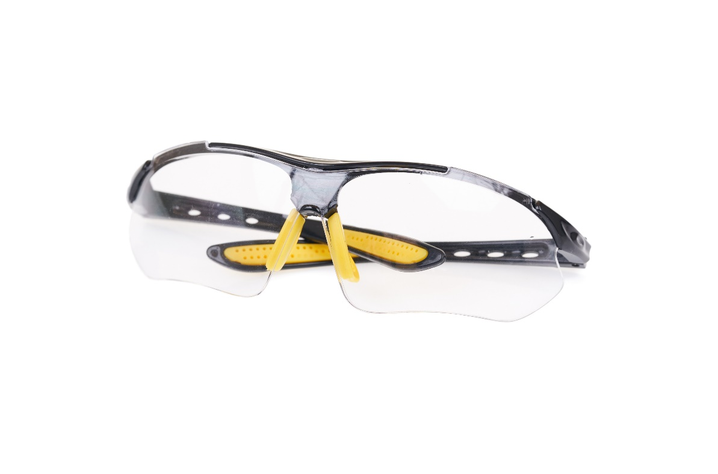
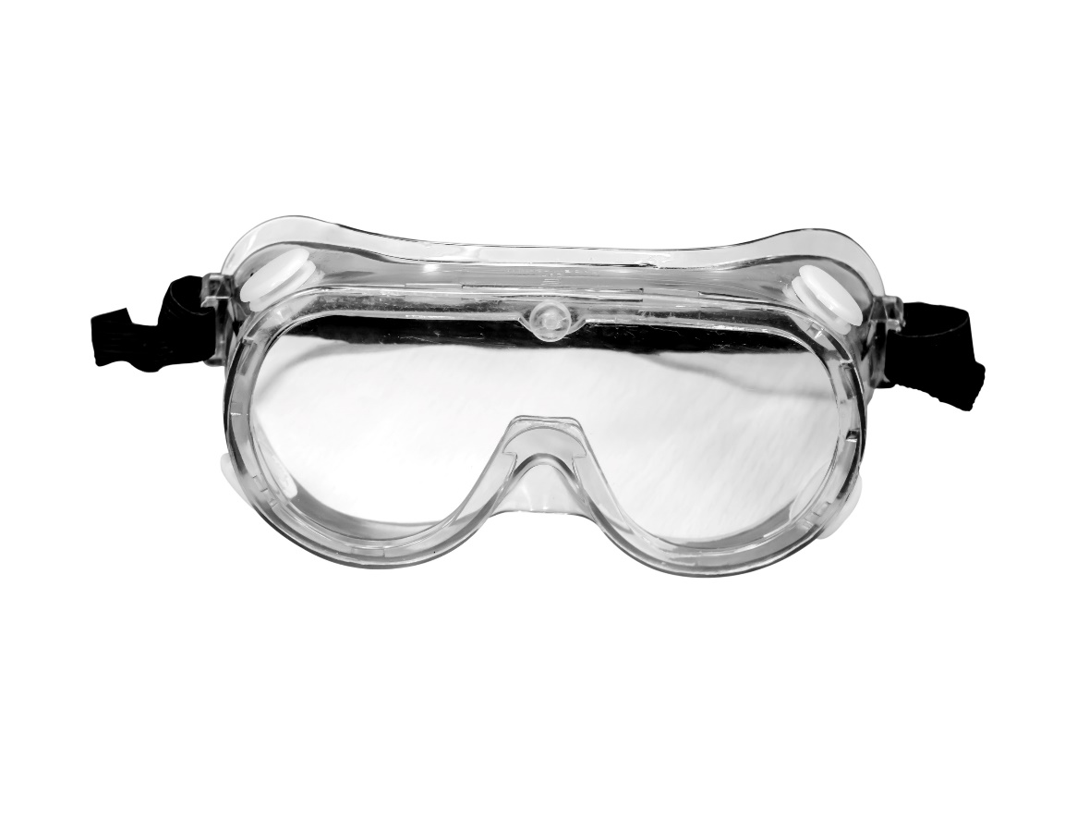
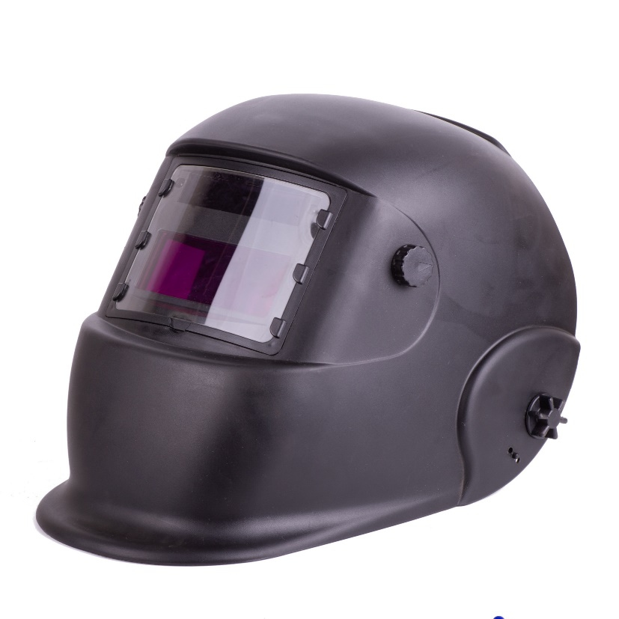
Eye and Face Protection – Examples of PPE
Examples of PPE:
Safety glasses
Goggles
Face shield

Slide 50
Eye and Face Protection – Use and Care
Video:
How to put protective eyewear on properly
How to adjust eye and face protection
Training: Use and Care
Limitations of eye and face protection:
Safety glasses - provide minimal to no protection from liquids or vapors
Goggles - can fog when in use
Face shields- do not protect employees from impact hazards
Inspection: How to identify signs of wear such as:
Chipped, scratched, or scraped lenses
Loss of elasticity or fraying of head bands
Care: How to clean and disinfect eye and face protection?

Slide 51
Let’s Review : Eye and Face Protection
Why are eye and face protection necessary?
Give examples of eye and face protection
What are some common confined space hazards that threaten the eyes and face?
How will eye and face protection protect from hazards in a confined space?

Slide 52
1926.103- Respiratory Protection
Standard Requirements:
The requirements applicable to construction work are identical to those in general industry - 29 CFR 1910.134.
Written program
Medical evaluation
Fit testing
Selection and use
Maintenance and care
Training
Program evaluation
Recordkeeping

Slide 53
Respiratory Protection
Common hazards in a confined space:
Lack of oxygen
Working with chemicals hazards
Toxic atmosphere hazards (dusts, fogs, fumes, mists, gases, smokes, sprays, fibers or vapors)

Slide 54
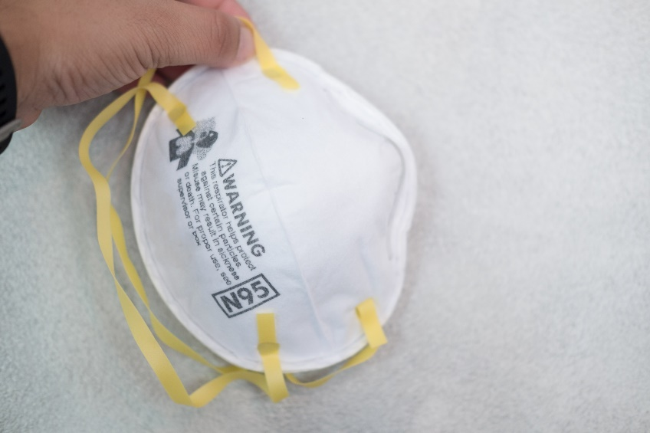
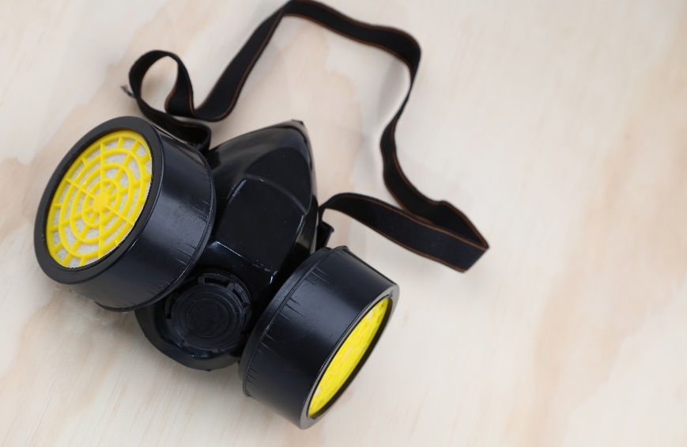
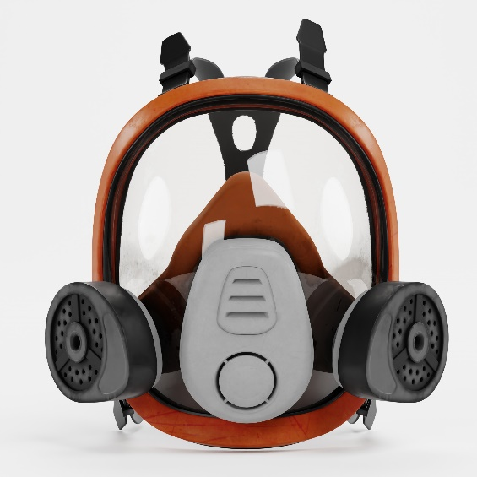
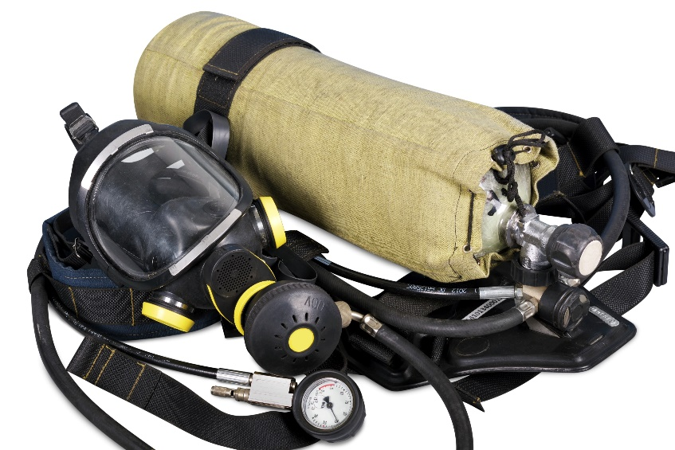
Respiratory Protection – Examples of PPE
Examples of PPE:
Air-purifying respirators (APR)
Dust mask
Half face
Full face
Loose-fitting powered air-purifying respirator (PAPR)
Hood powered air-purifying respirator (PAPR)
Supplied-air respirators
Supplied air respirator
Abrasive blasting continuous flow
Self-contained breathing apparatus (SCBA)

Slide 55
Respiratory Protection – Use and Care
Video:
How to put respiratory protection on properly
How to adjust respiratory protection
Training: Use and Care
Limitations of the respiratory protection:
Air-purifying respirators (APR)
Supplied-air respirators
Inspection: How to identify signs of wear such as:
Cracks, holes, tears, or breaks
Rippled or distorted facepiece edges
Fraying or deterioration of head strap/harness
Care: How to clean and disinfect respiratory protection?

Slide 56
Let’s Review : Respiratory Protection
Why is respiratory protection necessary?
Give examples of respiratory protection
What are some common confined space hazards that threaten the respiratory tract?
How will respiratory protection protect you from hazards in a confined space?

Slide 57
1926 Subpart E - Personal Protective & Life Saving Equipment
1926.104 - Safety belts, lifelines, and lanyards
https://www.osha.gov/laws-regs/regulations/standardnumber/1926/1926.104
1926.105 - Safety nets
https://www.osha.gov/laws-regs/regulations/standardnumber/1926/1926.105

Slide 58
Life Saving Equipment
Lifelines, safety harnesses, and lanyards shall be used only for employee safeguarding
Notes:
1926.104(a)Lifelines, safety belts, and lanyards shall be used only for employee safeguarding. Any lifeline, safety belt, or lanyard actually subjected to in-service loading, as distinguished from static load testing, shall be immediately removed from service and shall not be used again for employee safeguarding.
1926.104(b)Lifelines shall be secured above the point of operation to an anchorage or structural member capable of supporting a minimum dead weight of 5,400 pounds.

Slide 59
What is a Lifeline
A lifeline is a component consisting of a flexible line for connection to an anchorage at one end to hang vertically (vertical lifeline) or for connection to anchorages at both ends to stretch horizontally (horizontal lifeline), and which serves as a means for connecting other components of a Personal Fall Arrest System (PFAS) to the anchorage
Notes:
1926.104(a)Lifelines, safety belts, and lanyards shall be used only for employee safeguarding. Any lifeline, safety belt, or lanyard actually subjected to in-service loading, as distinguished from static load testing, shall be immediately removed from service and shall not be used again for employee safeguarding.
1926.104(b)Lifelines shall be secured above the point of operation to an anchorage or structural member capable of supporting a minimum dead weight of 5,400 pounds.

Slide 60
Life Saving Equipment (continued)
Any lifeline, safety harness, or lanyard actually subjected to in-service loading, as distinguished from static load testing, shall be immediately removed from service and shall not be used again for employee safeguarding
Lifelines shall be secured above the point of operation to an anchorage or structural member capable of supporting a minimum dead weight of 5,400 pounds
Notes:
1926.104(a)Lifelines, safety belts, and lanyards shall be used only for employee safeguarding. Any lifeline, safety belt, or lanyard actually subjected to in-service loading, as distinguished from static load testing, shall be immediately removed from service and shall not be used again for employee safeguarding.
1926.104(b)Lifelines shall be secured above the point of operation to an anchorage or structural member capable of supporting a minimum dead weight of 5,400 pounds.

Slide 61
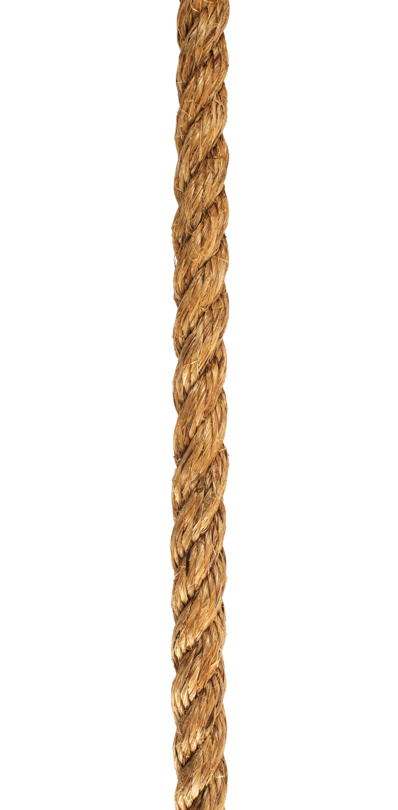
Lifelines
Lifelines used in areas where the lifeline may be subjected to cutting or abrasion (example rock scaling operation), shall be a minimum of 7/8 -inch wire core manila rope
For all other lifeline applications, a minimum of 3/4 -inch manila or equivalent, with a minimum breaking strength of 5,000 pounds, shall be used
Notes:
1926.104(c)Lifelines used on rock-scaling operations, or in areas where the lifeline may be subjected to cutting or abrasion, shall be a minimum of 7⁄8 -inch wire core manila rope. For all other lifeline applications, a minimum of 3⁄4 -inch manila or equivalent, with a minimum breaking strength of 5,000 pounds, shall be used.
1926.104(d)Safety belt lanyard shall be a minimum of 1⁄2 -inch nylon, or equivalent, with a maximum length to provide for a fall of no greater than 6 feet. The rope shall have a nominal breaking strength of 5,400 pounds.

Slide 62
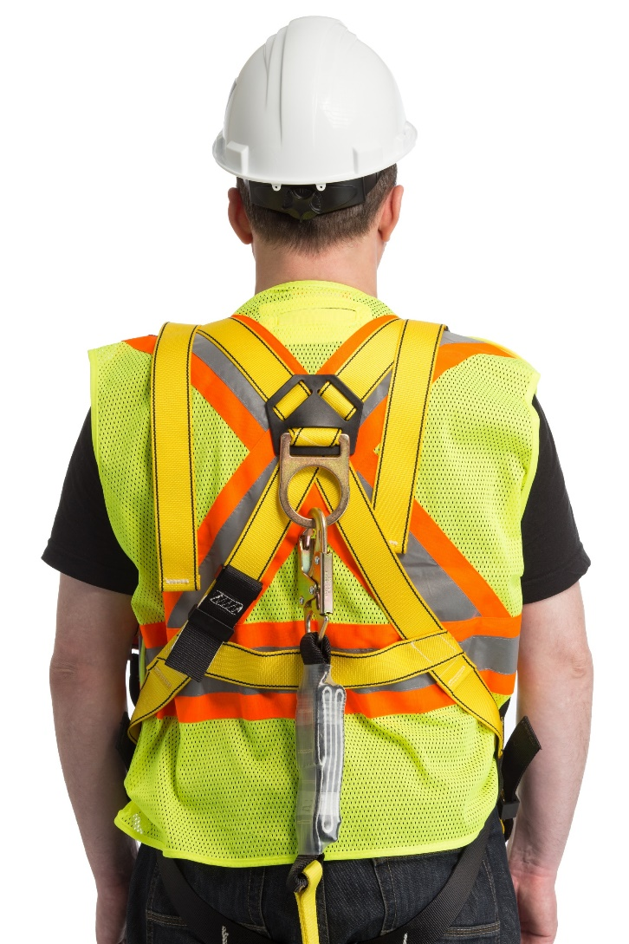
Safety Belt Lanyards
Safety belt lanyard shall be a minimum of 1/2 -inch nylon, or equivalent, with a maximum length to provide for a fall of no greater than 6 feet
The rope shall have a nominal breaking strength of 5,400 pounds
Notes:
1926.104(c)Lifelines used on rock-scaling operations, or in areas where the lifeline may be subjected to cutting or abrasion, shall be a minimum of 7⁄8 -inch wire core manila rope. For all other lifeline applications, a minimum of 3⁄4 -inch manila or equivalent, with a minimum breaking strength of 5,000 pounds, shall be used.
1926.104(d)Safety belt lanyard shall be a minimum of 1⁄2 -inch nylon, or equivalent, with a maximum length to provide for a fall of no greater than 6 feet. The rope shall have a nominal breaking strength of 5,400 pounds.

Slide 63
Safety Belts and Lanyards
Safety belt and lanyard hardware shall be drop forged or pressed steel, cadmium plated in accordance with type 1, Class B plating specified in Federal Specification QQ-P-416. Surface shall be smooth and free of sharp edges.
Safety belt and lanyard hardware, except rivets, shall be capable of withstanding a tensile loading of 4,000 pounds without cracking, breaking, or taking a permanent deformation
Notes:
1926.104(e)All safety belt and lanyard hardware shall be drop forged or pressed steel, cadmium plated in accordance with type 1, Class B plating specified in Federal Specification QQ-P-416. Surface shall be smooth and free of sharp edges.
1926.104(f)All safety belt and lanyard hardware, except rivets, shall be capable of withstanding a tensile loading of 4,000 pounds without cracking, breaking, or taking a permanent deformation.

Slide 64
Safety Net Requirements
Safety nets shall be provided when workplaces are more than 25 feet above the ground or water surface, or other surfaces where the use of ladders, scaffolds, catch platforms, temporary floors, safety lines, or safety belts is impractical
Where safety net protection is required, operations shall not be undertaken until the net is in place and has been tested
Notes:
1926.105(a)Safety nets shall be provided when workplaces are more than 25 feet above the ground or water surface, or other surfaces where the use of ladders, scaffolds, catch platforms, temporary floors, safety lines, or safety belts is impractical.
1926.105(b)Where safety net protection is required by this part, operations shall not be undertaken until the net is in place and has been tested.
1926.105(c)

Slide 65
Safety Net Requirements (continued)
Nets shall extend 8 feet beyond the edge of the work surface where employees are exposed and shall be installed as close under the work surface as practical, but in no case more than 25 feet below such work surface
Nets shall be hung with sufficient clearance to prevent user's contact with the surfaces or structures below. Such clearances shall be determined by impact load testing.
It is intended that only one level of nets be required for bridge construction
Notes:
1926.105(c)(1)Nets shall extend 8 feet beyond the edge of the work surface where employees are exposed and shall be installed as close under the work surface as practical but in no case more than 25 feet below such work surface. Nets shall be hung with sufficient clearance to prevent user's contact with the surfaces or structures below. Such clearances shall be determined by impact load testing.
1926.105(c)(2)It is intended that only one level of nets be required for bridge construction.

Slide 66
Safety Nets
The mesh size of nets shall not exceed 6 inches by 6 inches
All nets shall meet accepted performance standards of 17,500 foot-pounds minimum impact resistance as determined and certified by the manufacturers and shall bear a label of proof test
Notes:
1926.105(d)The mesh size of nets shall not exceed 6 inches by 6 inches. All new nets shall meet accepted performance standards of 17,500 foot-pounds minimum impact resistance as determined and certified by the manufacturers, and shall bear a label of proof test. Edge ropes shall provide a minimum breaking strength of 5,000 pounds.
1926.105(e)Forged steel safety hooks or shackles shall be used to fasten the net to its supports.
1926.105(f)Connections between net panels shall develop the full strength of the net.

Slide 67
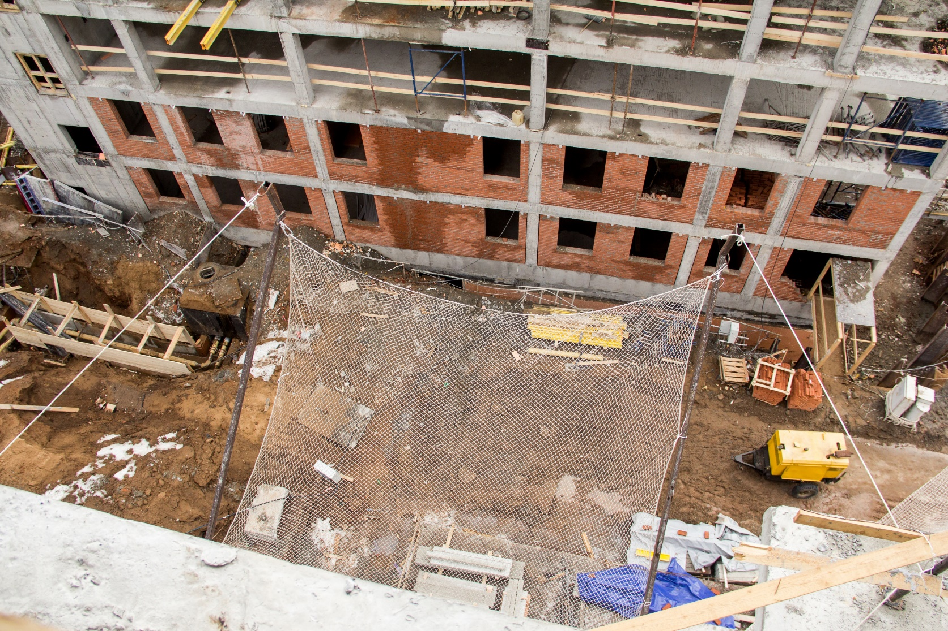
Safety Nets (continued)
Edge ropes shall provide a minimum breaking strength of 5,000 pounds
Forged steel safety hooks or shackles shall be used to fasten the net to its supports
Connections between net panels shall develop the full strength of the net
Notes:
1926.105(d)The mesh size of nets shall not exceed 6 inches by 6 inches. All new nets shall meet accepted performance standards of 17,500 foot-pounds minimum impact resistance as determined and certified by the manufacturers, and shall bear a label of proof test. Edge ropes shall provide a minimum breaking strength of 5,000 pounds.
1926.105(e)Forged steel safety hooks or shackles shall be used to fasten the net to its supports.
1926.105(f)Connections between net panels shall develop the full strength of the net.

Slide 68
Behavior Based Safety
Behavior-Based Safety
Notes:
1926 Subpart E - Personal Protective and Life Saving Equipment

Slide 69
What is a Behavior-Based Safety Program (BBS)
The Behavior-Based Safety (BBS) program:
Takes in consideration of people’s attitudes, beliefs and feelings about safety at the workplace, and unearths the root causes of potential hazards and unsafe behaviors
People are the most valuable resource
People need the knowledge and confidence to make the right safety decisions

Slide 70
Employer’s Role
Commitment to safety and health
Promote a cooperative atmosphere between (employer) management and employees
Allocate resources
Provide motivation, direction, and actions
Notes:
Without leadership from management, the safety and health program is doomed to fail.
Management provides a motivating force and, equally importantly, resources for the program.
Clearly written policy helps communicate that safety and health is a primary organizational value.

Slide 71
Behavior-Based Safety
Goals
Buy-in participation
Positive feedback
Components of
behavior-based safety

Slide 72
Goals
Set SMART monthly goals
Incentivize when goals are met

Slide 73
Buy-in Participation
Commitment from senior managers
Lead by example
Consistency – getting the same information into everyone’s hands
Timeliness - share at the appropriate time
Simplicity - mindset
Notes:
Here are some ways for management to make sure workers see and believe they’re involved and care:
Be seen on the floor in informal safety activities and inspections, etc.
Make yourself accessible to workers on health and safety issues
Lead by example, always knowing and following health and safety rules
Be involved in and actively participate in the safety and health committee, meetings, etc.

Slide 74
Positive Feedback
Reward system for smart safety decisions and practices
Contributes to a positive workplace
Helps to see the good in others
Promotes employee engagement and safety culture
Focus more on best work (choices)

Slide 75
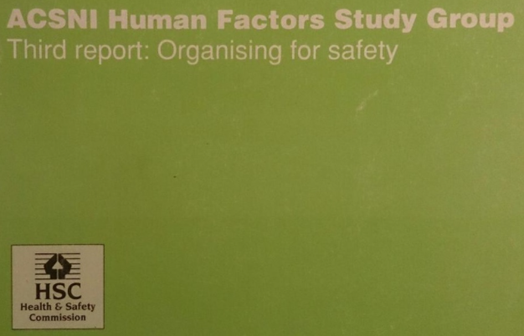
Definition: Safety Culture
“The safety culture of an organization is the product of individual and group values, attitudes, perceptions, competencies, and patterns of behavior that determine the commitment to, and the style and proficiency of, an organization’s health and safety management. Organizations with a positive safety culture are characterized by communications founded on mutual trust, by shared perceptions of the importance of safety and by confidence in the efficacy of preventive measures.”
ACSNI Human Factors Study Group: Third report - Organizing for safety HSE Books 1993

Slide 76
Benefits of a Safety Culture
Commitment to safety and health
Cooperative atmosphere between management and employees
Improvements in product, process, and quality
Better workplace morale
Improved recruitment and retention
A more favorable image and reputation

Slide 77
Core Elements for Safety Culture
Management commitment
Worker involvement
Supervisor leadership
Hazard identification and control
Training
Continuous improvement

Slide 78
Techniques to Promote Safety Culture
Positive attitude
Participation
Ownership
Flexibility
Technology

Slide 79
Behavior-Based Safety and Safety Culture
Safety culture does not happen by accident and is not one size fits all
Safety culture is determined by how people feel, what people do, and the organization’s safety policies and procedures (Cooper, 2000)
An established behavior - based safety (BBS) program in construction is a powerful tool to improve the safety culture within a company

